Slide 1

Twitter Follow Graph
Group 2
Rahul Maheshwari (MT19027)
P. Akshay Kumar (MT19094)
Piyush Pradeep Jain (MT19122)

Slide 2
Introduction
Twitter is one of the most popular social media platforms and has huge amount of user data which can be analyzed to derive useful information.
In this project, we aim to study its basic properties such as degree distribution, path length, clustering coefficient as well as advanced properties such as community detection and page rank.
We have generated an Twitter-ego network from Twitter dataset to compare its behaviour with the original dataset.
We compare the results of Twitter with other popular social media platforms such as Facebook, Linkedin, Flickr and Twitch.
We have developed a GUI to present the results of analysis on various social datasets in a succinct manner.

Slide 3
Dataset and Preprocessing
Dataset | Source
Twitter Follower Network, EU Email Network | SNAP repository
Linkedin, Flickr | http://networkrepository.com
Twitch, Facebook (unlabelled) | https://github.com/benedekrozemberczki/datasets#twitch-ego-nets
Facebook (labelled) | https://www.kaggle.com/rozemberczki/musae-facebook-pagepage-network
Preprocessing:
We have sampled sufficient data points from huge datasets such as Twitter, Linkedin in order to compute network related properties.
We have mapped and extracted user information using Twitter, Facebook API to represent communities and Page Rank on the GUI.

Slide 4
Network Properties
Network | Number of Nodes | Number of Edges | Average Path Length | Average Clustering Coefficient | Degree Assortativity | Diameter
Twitter | 98292 | 212314 | 2.612596 | 0.076286 | -0.08114 | 18
Twitter-Ego | 429 | 11416 | 2.505563 | 0.28431 | -0.14497 | 8
EU Email | 1005 | 25570 | 2.652826 | 0.372703 | 0.004335 | 7
Twitch_FR | 6549 | 112666 | 2.680991 | 0.221706 | -0.17815 | 7
Twitch_ENGB | 7126 | 35324 | 3.677616 | 0.130928 | -0.12191 | 10
Linkedin | 2122488 | 4626421 | - | 0.267394 | -0.0732 | -
Flickr | 513969 | 3190452 | - | 0.167599 | 0.157802 | -
Facebook_Public_Figure | 11565 | 67114 | 4.622979 | 0.179347 | 0.202162 | 15
Facebook_Politician | 5908 | 41729 | 4.664107 | 0.385096 | 0.018244 | 14
Facebook_Athletes | 13866 | 86858 | 4.274809 | 0.276188 | -0.0269 | 11
Note: The average path length and diameter fields are blank for Linkedin and Flickr because of high density of the networks and the time taken to compute the properties was too high even with BFS flood fill algorithm.

Slide 5
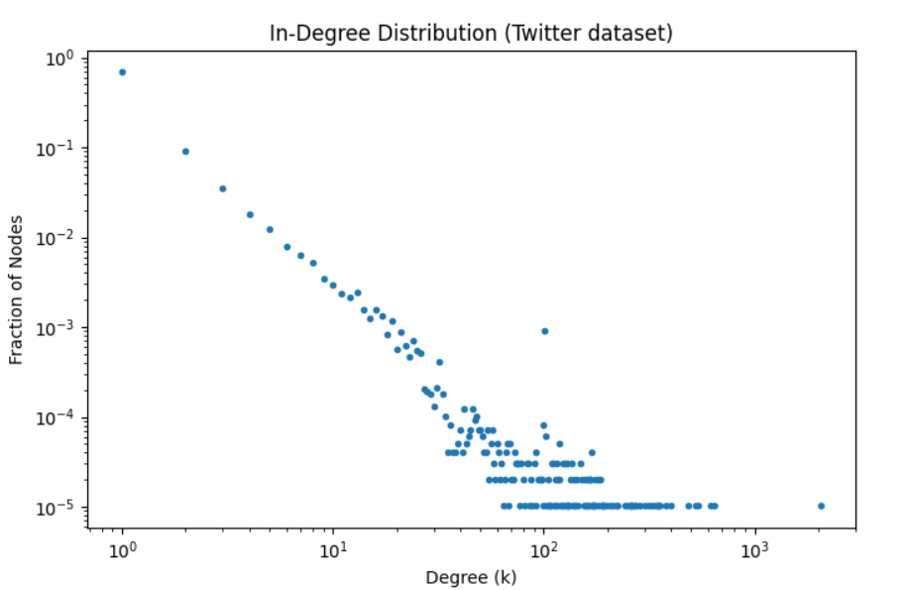
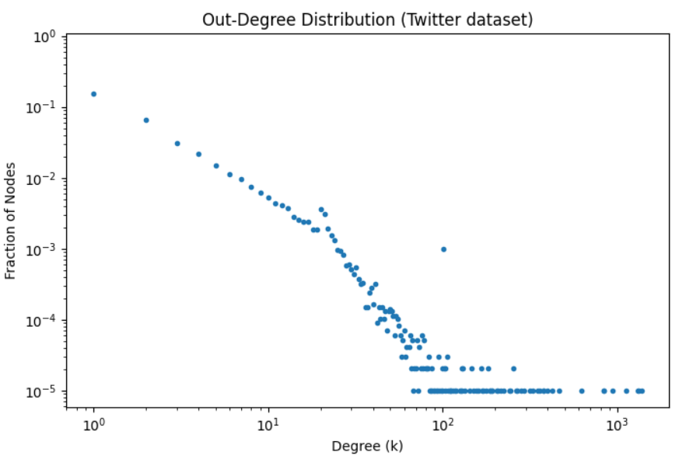
Plots [Directed graphs degree distribution]

Slide 6
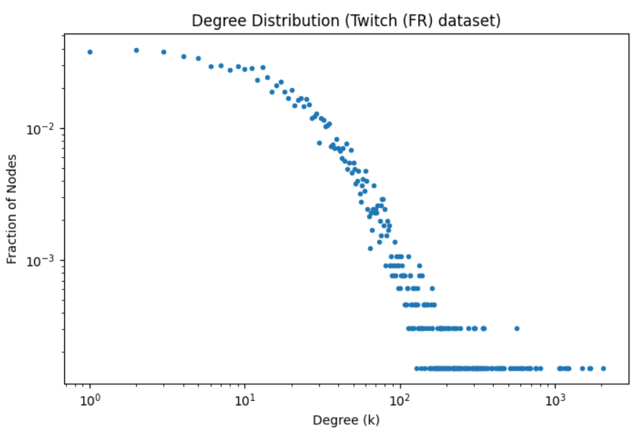
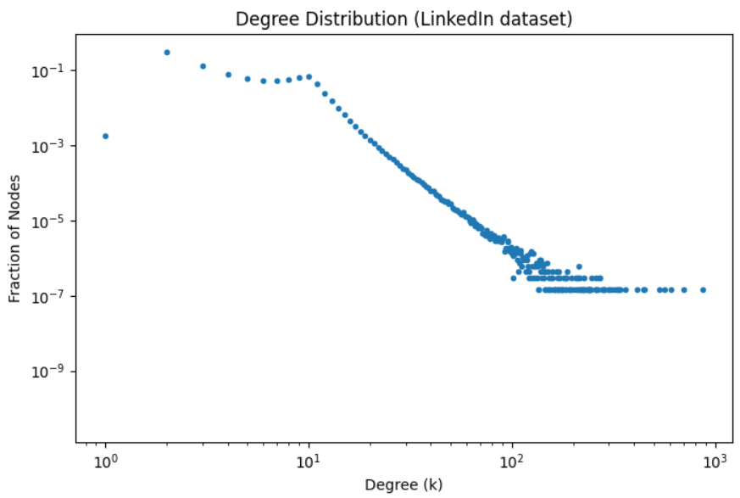
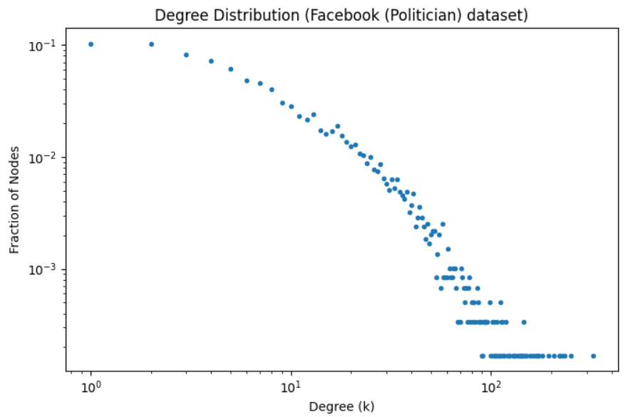
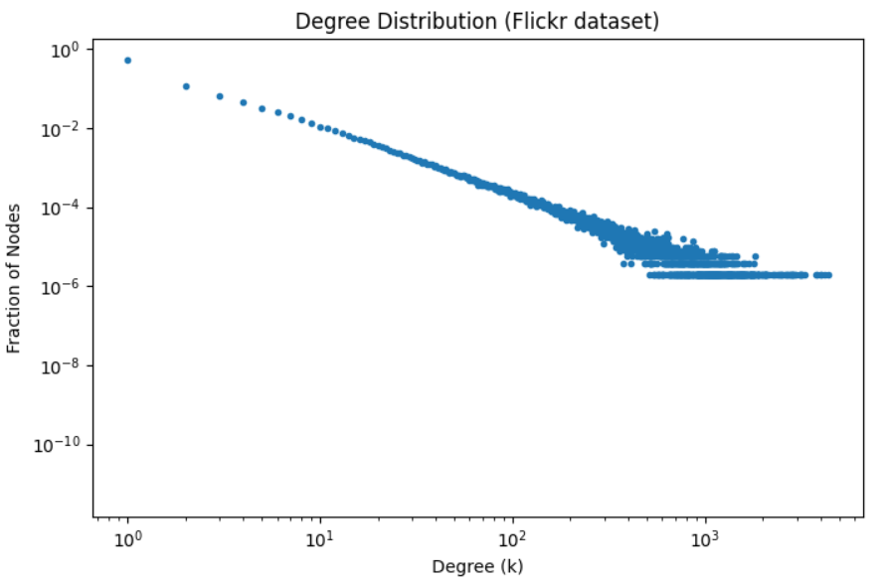
Plots [Undirected graphs degree distribution]

Slide 7
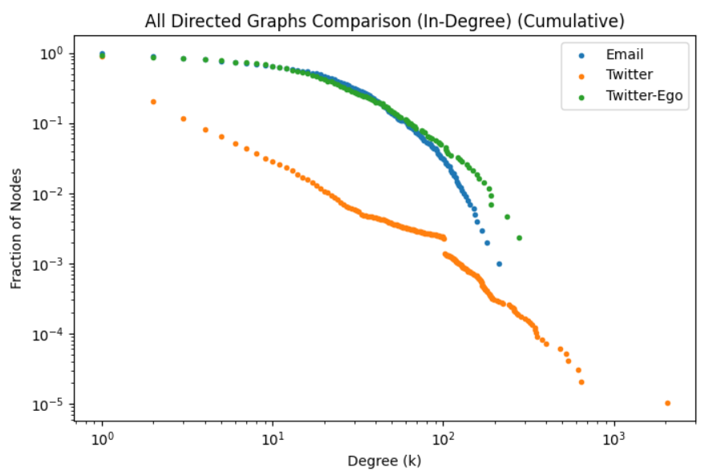
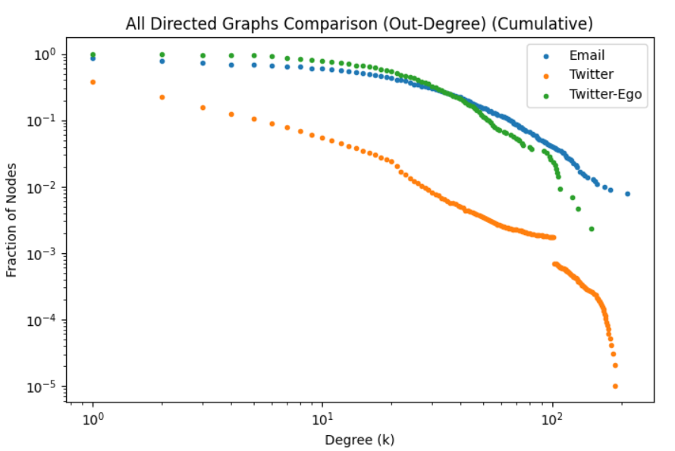
Plots [Cumulative distribution - Directed]

Slide 8
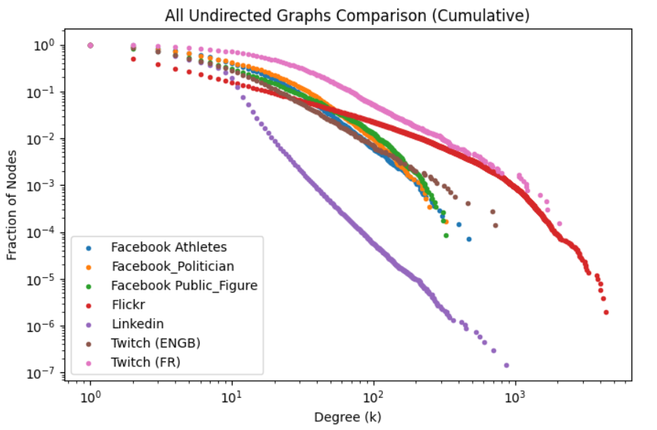
Plots [Cumulative distribution - Undirected]

Slide 9
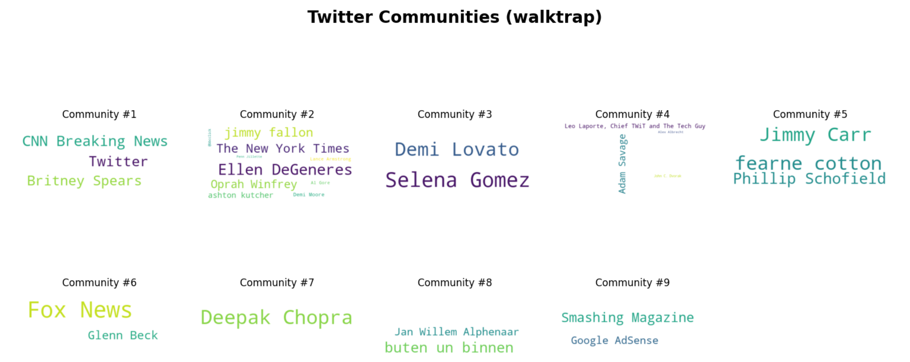
Community detection algorithms
Community algorithms explored: Leiden, Surprise communities, Walktrap

Slide 10
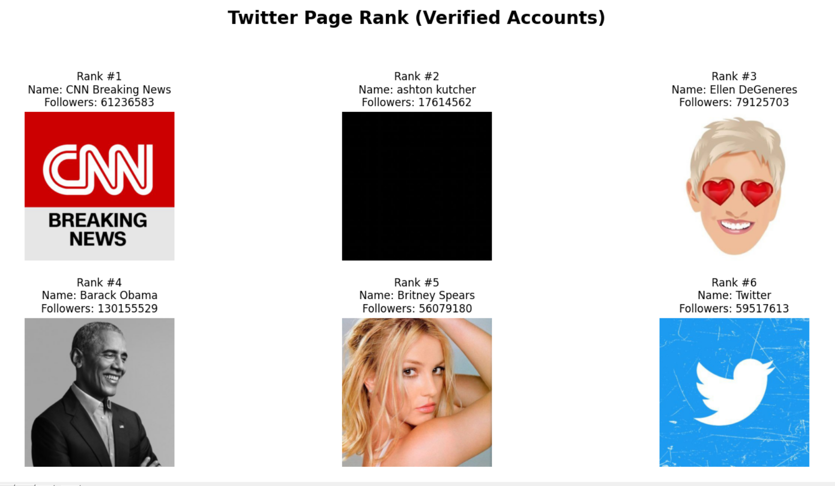
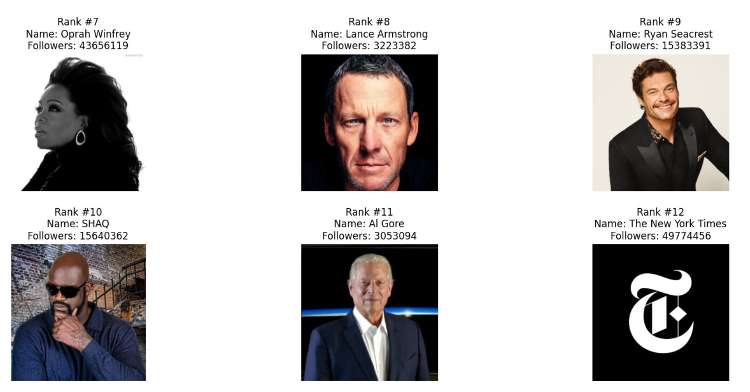
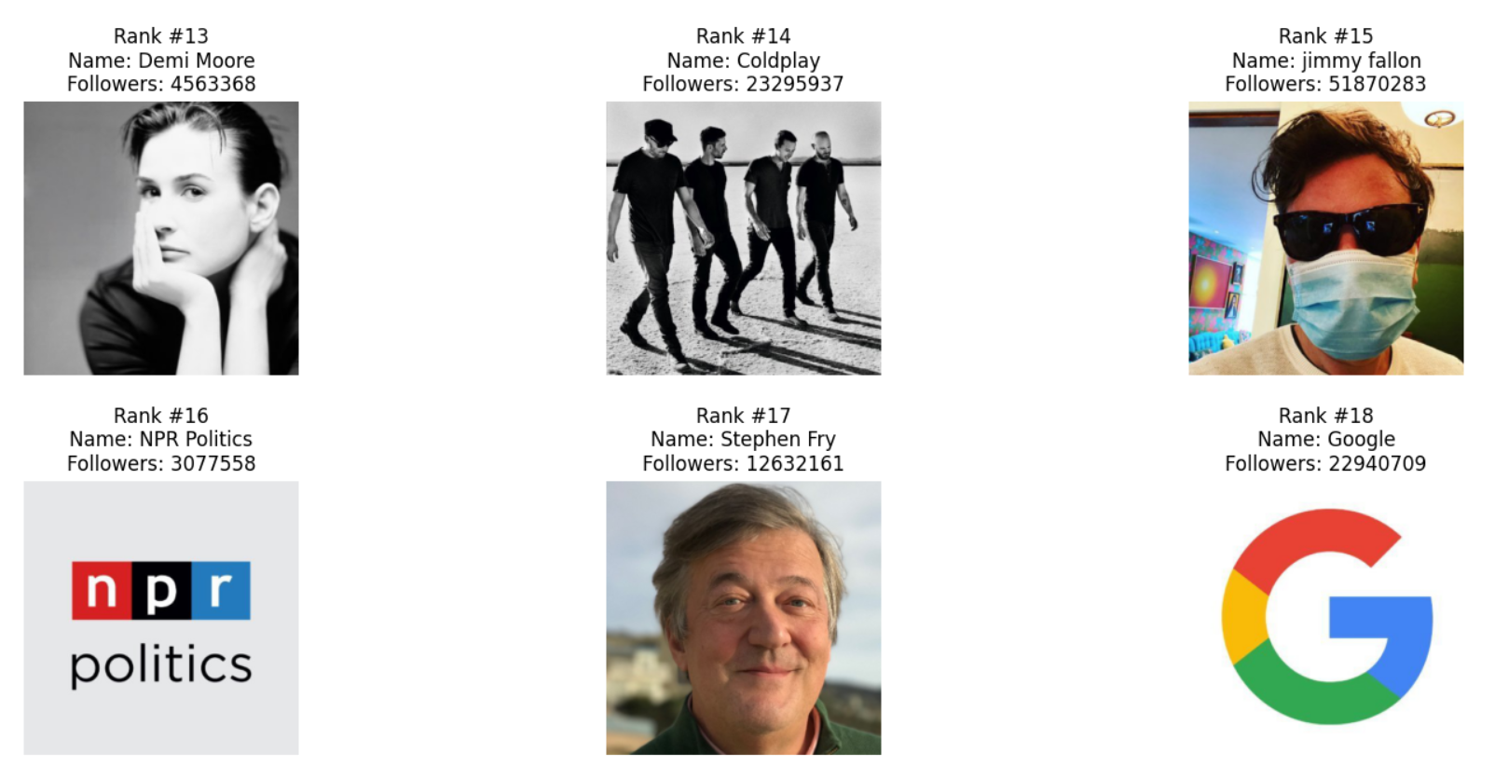
PageRank Output

Slide 11
Contributions
Group member name | Contribution
Rahul Maheshwari (MT19027) | Fetching user information from Twitter, Facebook for advanced properties, GUI development and project blog
Piyush Pradeep Jain (MT19122) | Preprocessing, community detection and page rank analysis, generation of plots, graphs using Gephi
P. Akshay Kumar (MT19094) | Preprocessing, basic graph properties computation such as degree distribution, average path length, clustering coefficient etc.

Slide 12
Thank You!

